Slide 1



The Workaholics
Cryptography Simulation with mbedTLS/OpenSSL
Presented by: The Workaholics Team

Slide 2

PROBLEM STATEMENT
“Cryptography Simulation with mbedTLS/OpenSSL"

Slide 3


OBJECTIVE:
Develop an interactive simulation using C++ and OpenSSL.
Focus on encryption, decryption, RSA key generation, and cryptographic algorithms.

Slide 4

Unique Idea Brief (Solution)
Interactive Environment
Real-World Examples
Educational Content
This project proposes a unique cryptography simulation system with a user-friendly interface, interactive features, and comprehensive educational content using mbedTLS or OpenSSL libraries, offering practical experience with cryptographic algorithms and protocols. It also aims to develop a Sigma protocol-based secure voting platform to ensure voter anonymity, vote integrity, and prevent tampering, addressing critical challenges in digital voting security with advanced cryptographic techniques.

Slide 5

KEY FEATURES
Real-Time Simulation
Interactive Lab Environment
Scenario-Based Learning
Error Analysis and Debugging
Collaboration and Sharing
Integration with Popular
Development Environments

Slide 6

Feature | Description
Encryption Algorithms | AES, DES, RSA, ECC
Hashing Algorithms | SHA-256, MD5
Digital Signatures | RSA, ECC
Cryptographic Protocols | TLS/SSL, SSH
Interactive Tools | Encryption/Decryption, Key Generation, Vulnerability Analysis

Slide 7
PROCESS FLOW
Initialization
The simulation begins by initializing the mbedTLS and OpenSSL libraries, setting up the necessary cryptographic context and configurations.
1
2
Algorithm Selection
Users will have the ability to select a specific cryptographic algorithm from a list of available options, such as AES, RSA, or SHA-256.
Key Generation
The simulation will generate cryptographic keys based on the chosen algorithm. These keys will be used for encryption, decryption, signing, or verification.
3
4
Data Processing
Users can input data to be processed using the selected algorithm and keys. The simulation will perform the desired cryptographic operation, such as encryption or hashing.
Output and Analysis
The simulation will display the processed output, allowing users to analyze the results and understand the impact of the chosen cryptographic algorithm or protocol.
5

Slide 8
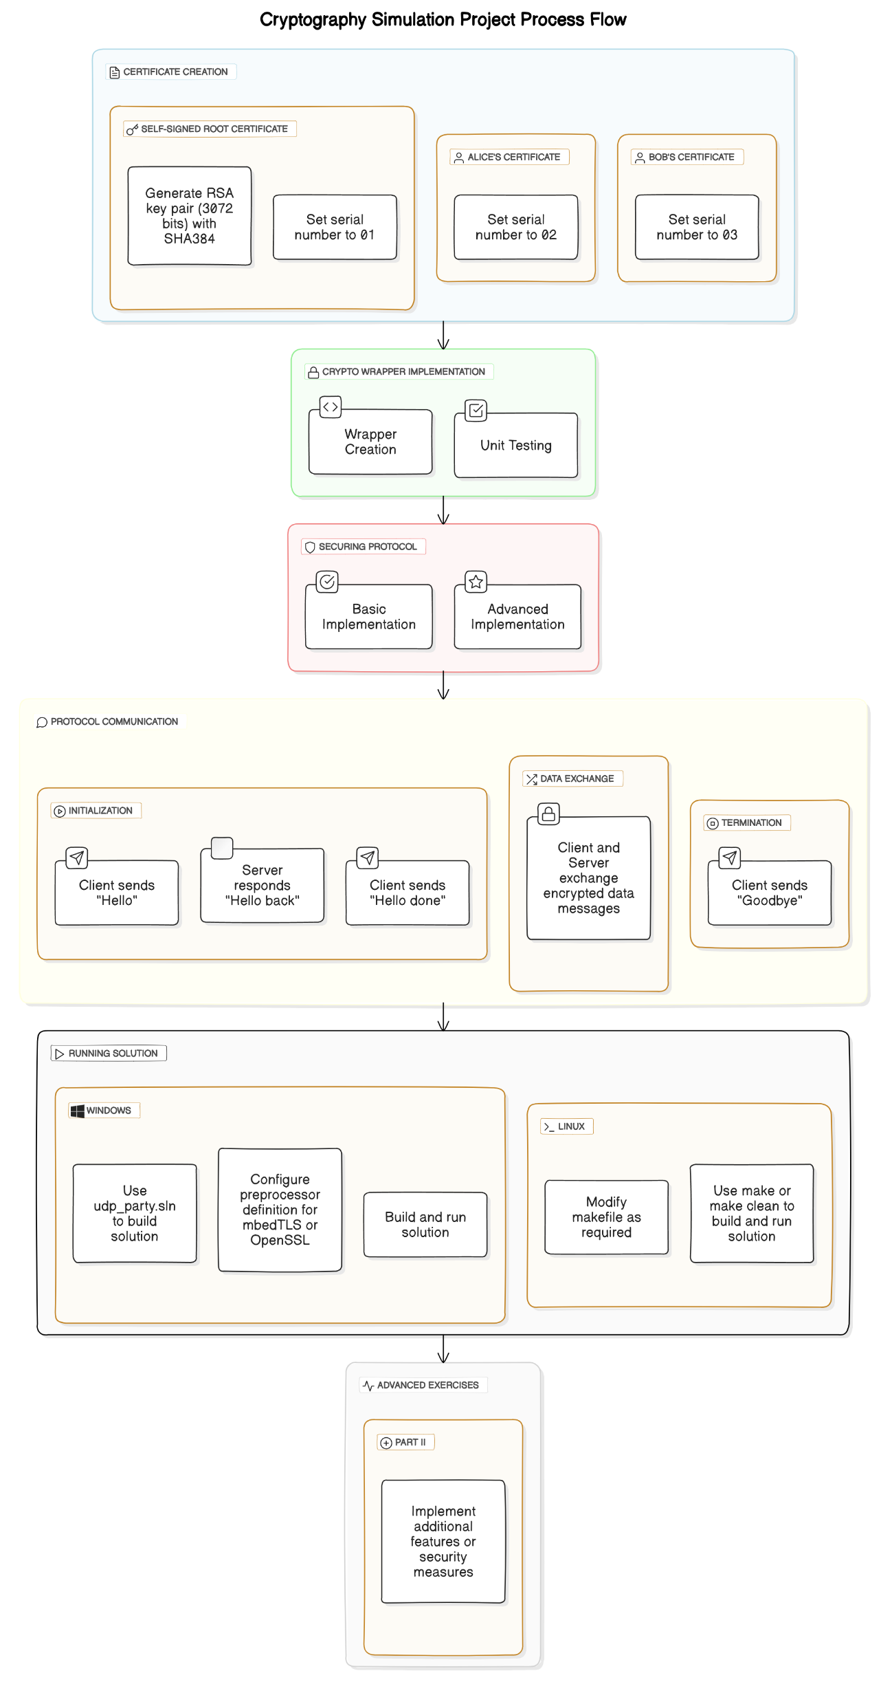

Slide 9



TECHNOLOGIES USED
The cryptography simulation will use Visual Studio Code (VS Code) from Microsoft is a popular integrated development environment (IDE) known for its lightweight yet powerful features, particularly suitable for C++ development and integration with OpenSSL libraries. This combination ensures compatibility with chosen libraries and a user-friendly experience.
C++
Core programming language for performance and efficiency.
Visual Studio Code
It is a streamlined code editor with support for development operations like debugging, task running, and version control.
OpenSSL
Open-source cryptography toolkit for a wide range of applications.

Slide 10
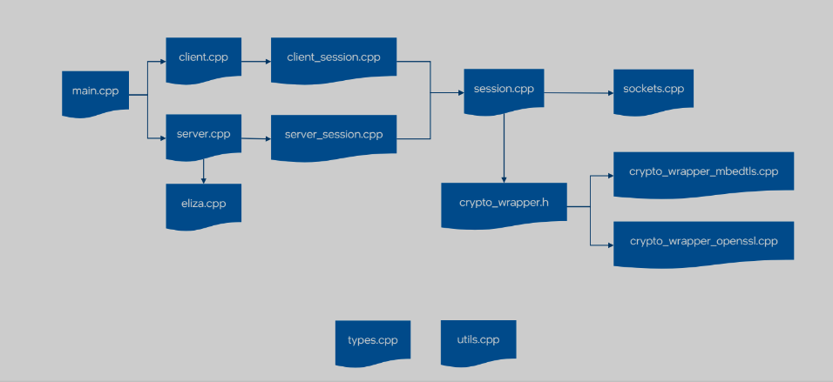
CODE STRUCTURE

Slide 11
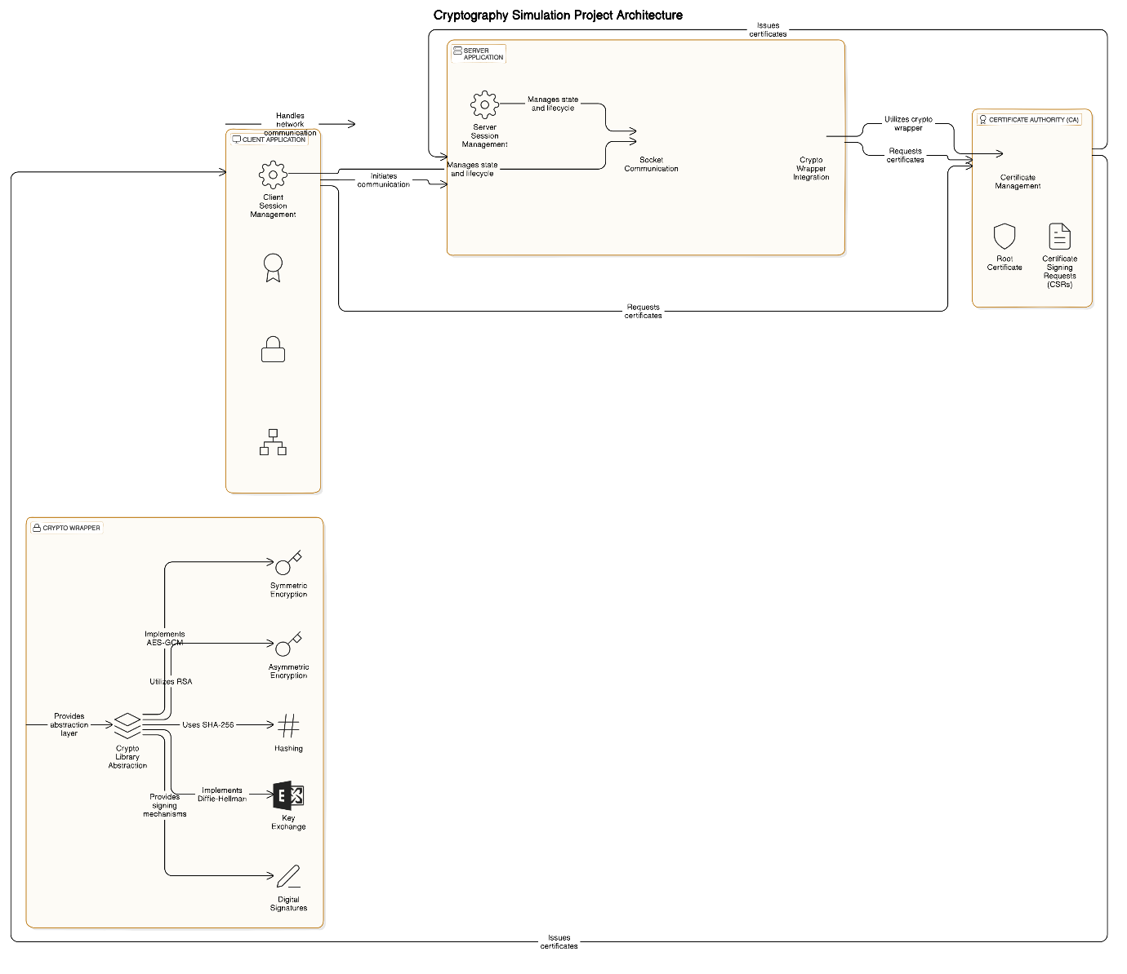
ARCHITECTURE DIAGRAM

Slide 12
TEAM MEMBERS
AND CONTRIBUTIONS
VIPPAGUNTA HIMACHARITHA
- As a team leader, I Designed the overall architecture of the project and I also contributed my part by managing, communicating and motivating my team members along with the sprints of the project.
PAVANA MADDIREDDY
- As a team member, I developed the crypto wrapper using OpenSSL and test cryptographic functionalities(ex: AES-GCM, RSA, SHA-256,DH)
PUTTA VENKATA PUSHPA
- As a team member, I Implemented and managed the socket communication for the client and the server applications. Also, Ensure the cryptographic protocols are secure and efficient.
ARIGELA YASHASWINI
- As a team member, I ensured reliable and secure network communication over UDP and monitored network traffic by analysing it using Wireshark. Also, Troubleshoot and resolve any network related issues.
MINI GADHIRAJU
- As a team member, I provided support for certificate management by generating certificates, signing certificates and verifying them.

Slide 13
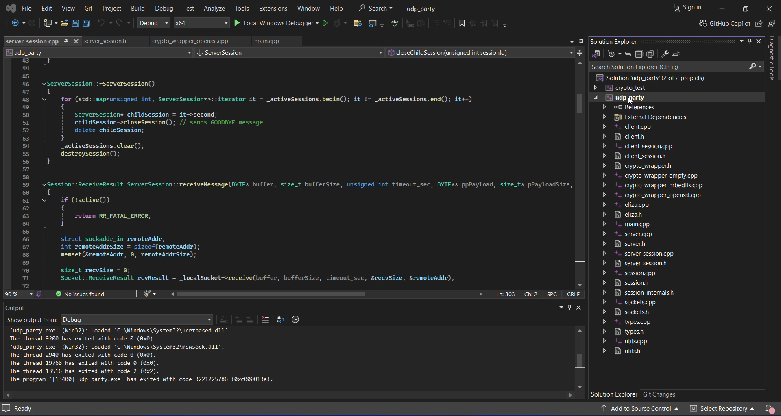
DEMO VIDEO

Slide 14

CONCLUSION
The cryptography simulation tool offers a serves educational purposes by providing a user-friendly and interactive platform that bridges the gap between theoretical knowledge and practical application. It enhances understanding of cybersecurity concepts, providing hands-on experience essential for real-world application. This approach not only enhances understanding of complex cryptographic concepts discussed in this chat but also equips users with practical skills essential for securing digital communications and data integrity in real-world scenarios.

